Slide 1
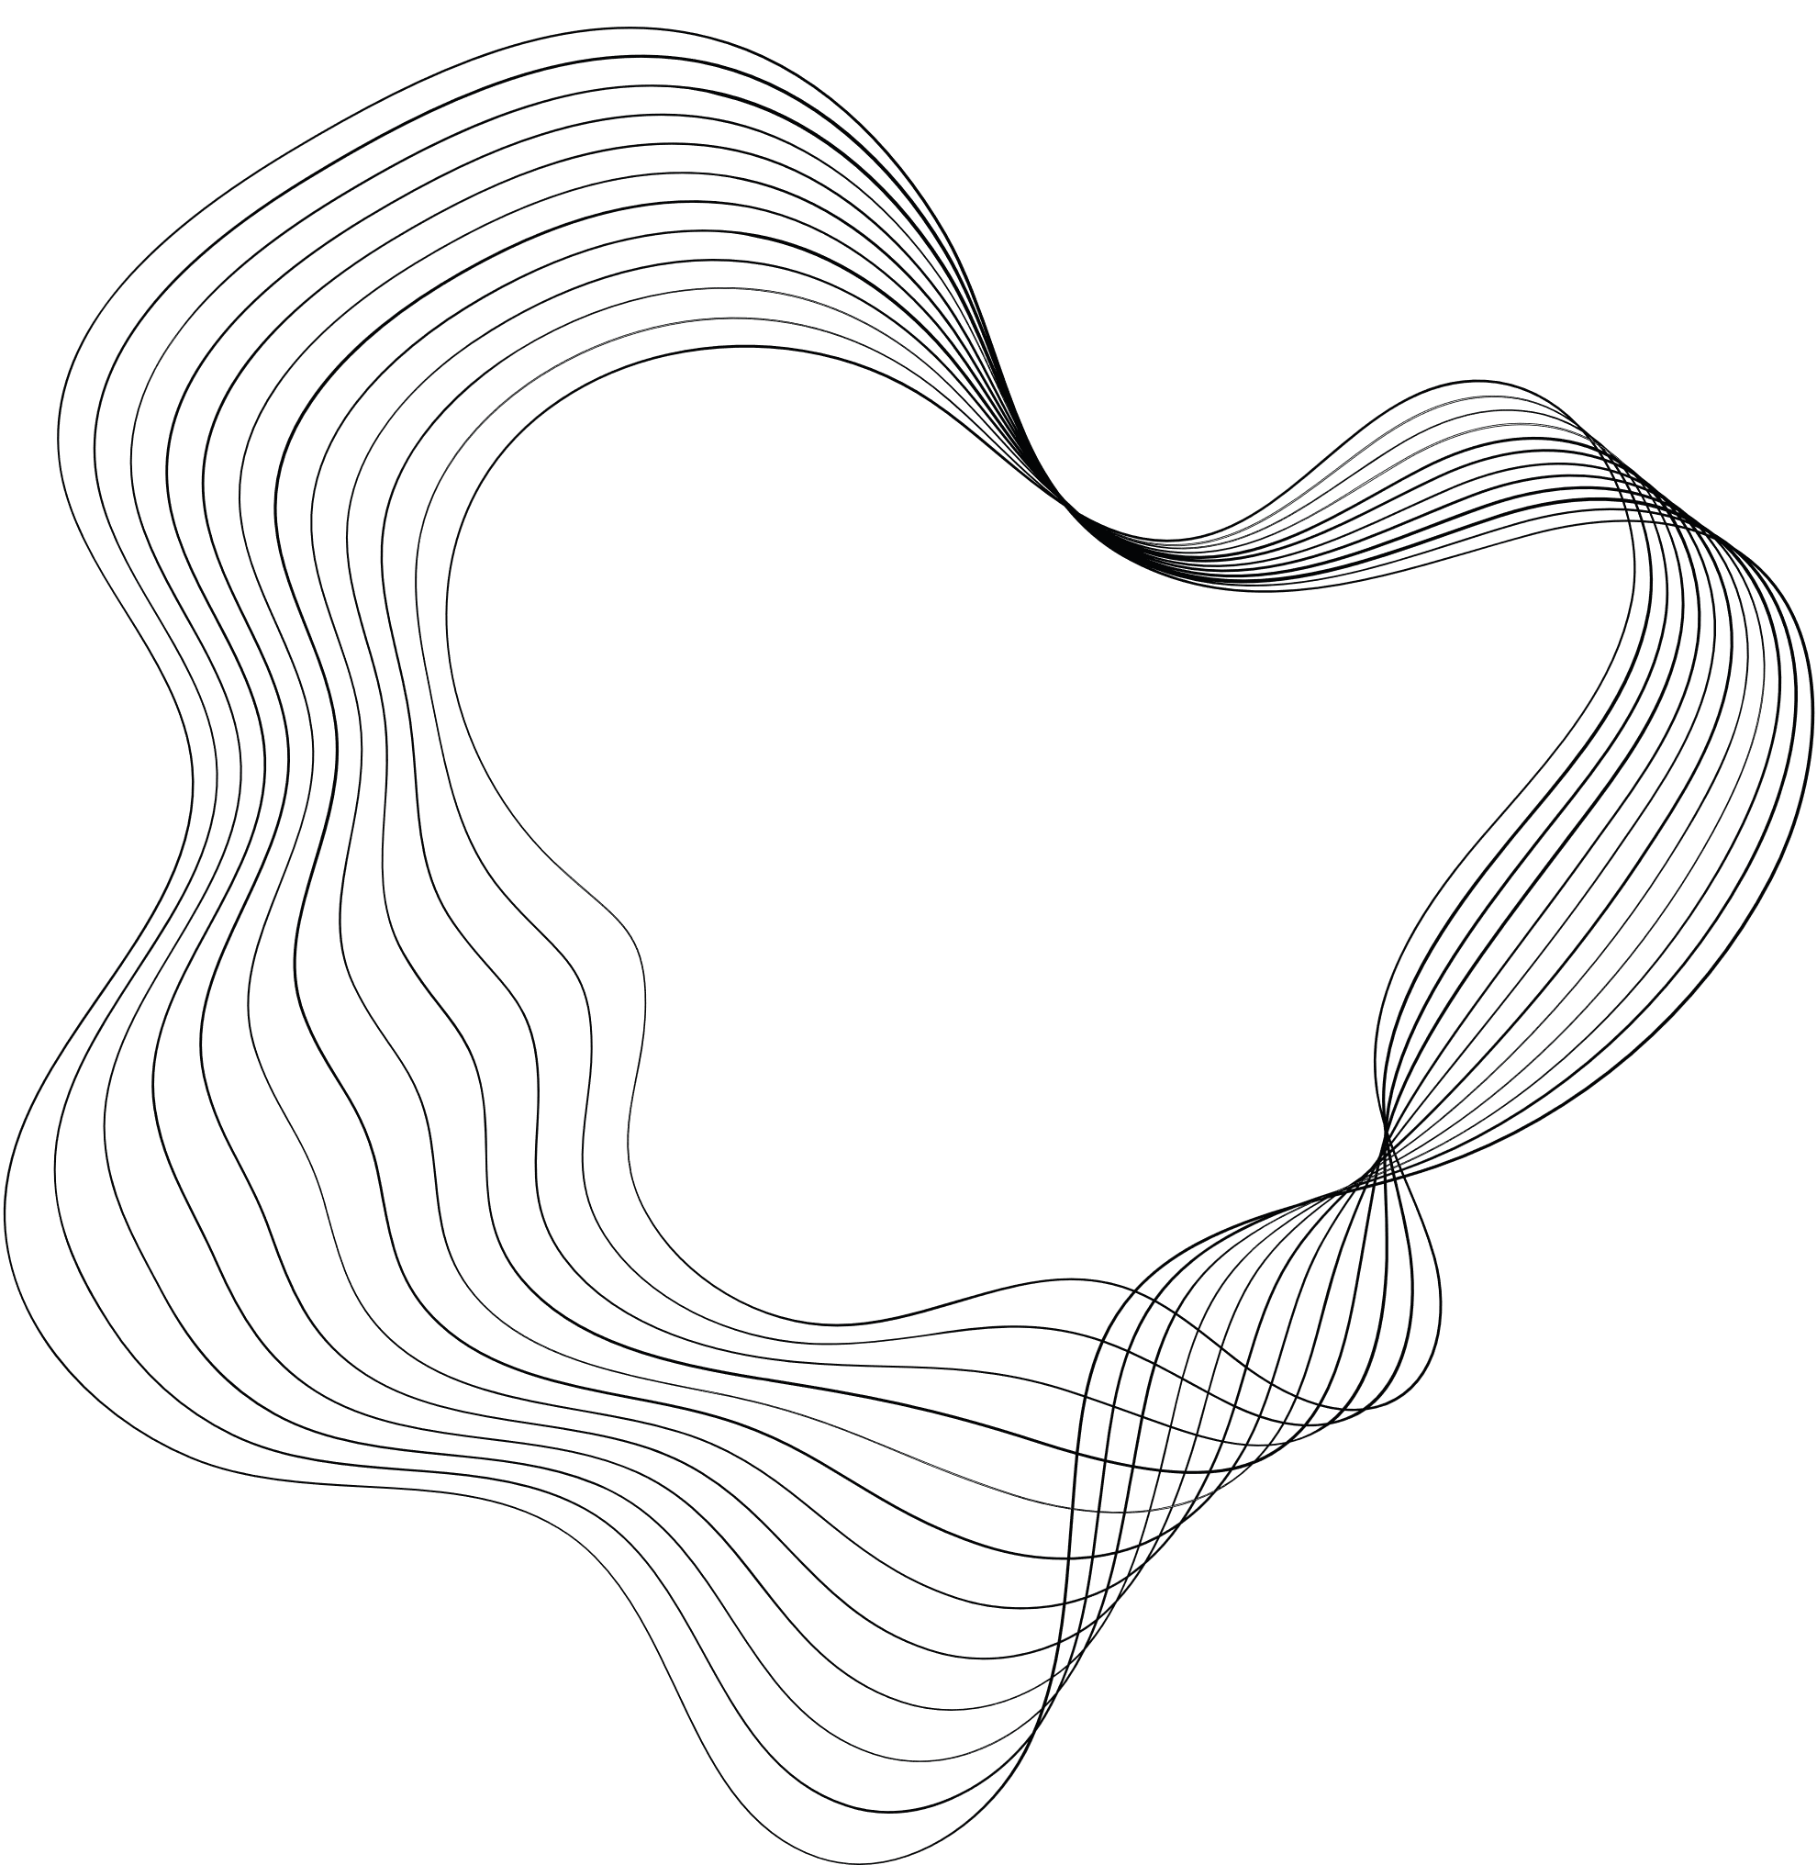


DA-IICT
EDA - GROUP 2
NATIONAL HEALTH RURAL MISSION
GUIDE: PROF. GOPINATH PANDA

Slide 2




OUR TEAM
Harshit Shah
Shashva Machar
Ayush Jain
Nakul Tomar
202218040
202218028
202218039
202218026

Slide 3

CONTENT
01
OUR TEAM
02
INTRODUCTION
03
TOOLS AND TECHNOLOGIES
04
METHODOLOGY
05
DATASETS (1 -6 ) EDA
06
CONCLUSION

Slide 4



INTRODUCTION
The National Rural Health Mission (NRHM) and National Urban Health Mission (NUHM) overview
Objectives: Providing accessible, affordable, and quality healthcare to rural populations
Focus on vulnerable groups and special emphasis on Empowered Action Group (EAG) states and northeastern states

Slide 5
Tools and Technologies
Python and various Python libraries used for analysis:
Pandas
Matplotlib
Seaborn
NumPy
Plotly Express
Ipywidgets
Scikit Learn
JSON

Slide 6


METHODOLOGY
01
02
03
04
05
06
07
COLLECTING AND LOADING THE DATA
DATA DESCRIPTION
DATA CLEANING AND PREPROCESSING
SUMMARIZING THE DATA
DATA VISUALIZATIONDATA VISUALIZATION
PREDICTIONS (IF POSSIBLE)
INTERPRETATIONS
For our analysis we couldn’t find a single dataset large enough to perform EDA therefore we decided to perform EDA on several small datasets. We collected datasets from data.gov.in website. Then we followed step by step procedure for each data set:

Slide 7
Dataset : 1
National Health Mission Budget/Funds: 2015-16 to 2022-23
Loading the dataset and obtaining information about the data
Handling null values

Slide 8
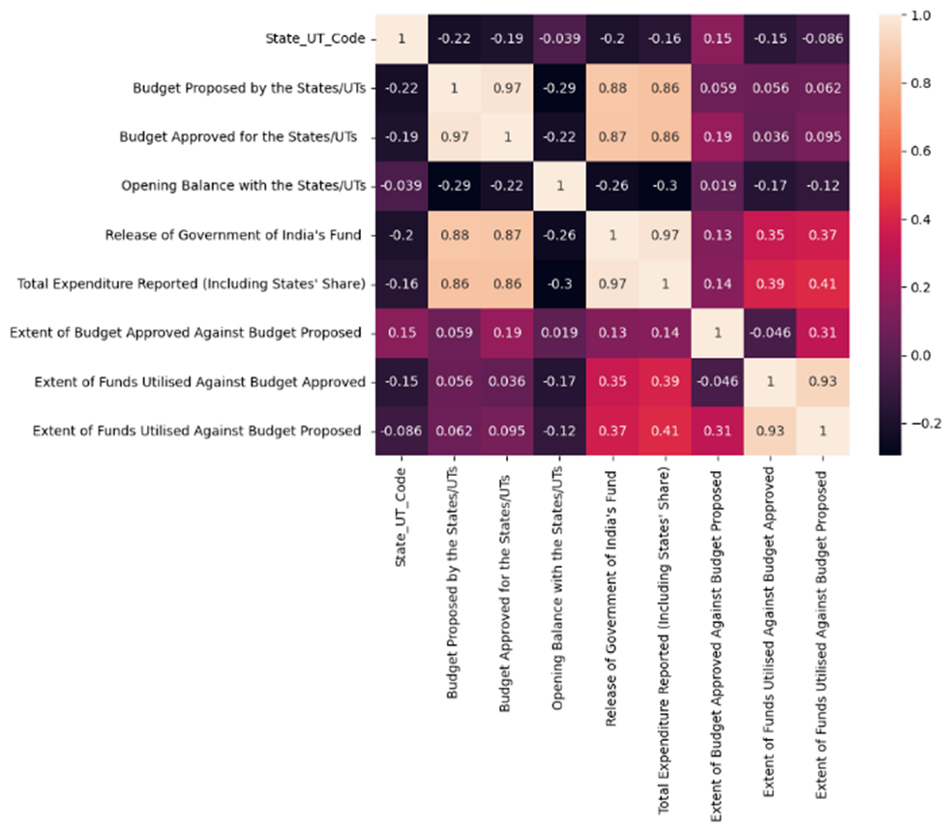
Correlation analysis and scatter plot visualization
Correlation heatmap between the features show that how each column is related to each other. From the graph it is evident that features like Budget Proposed and Budget Allocated are related to each other. Similarly Release of government of India fund is highly correlated to the expenditure.
Also, Extent of funds utilised against Budget approved is highly related to Extent of funds utilised against Budget Proposed.

Slide 9
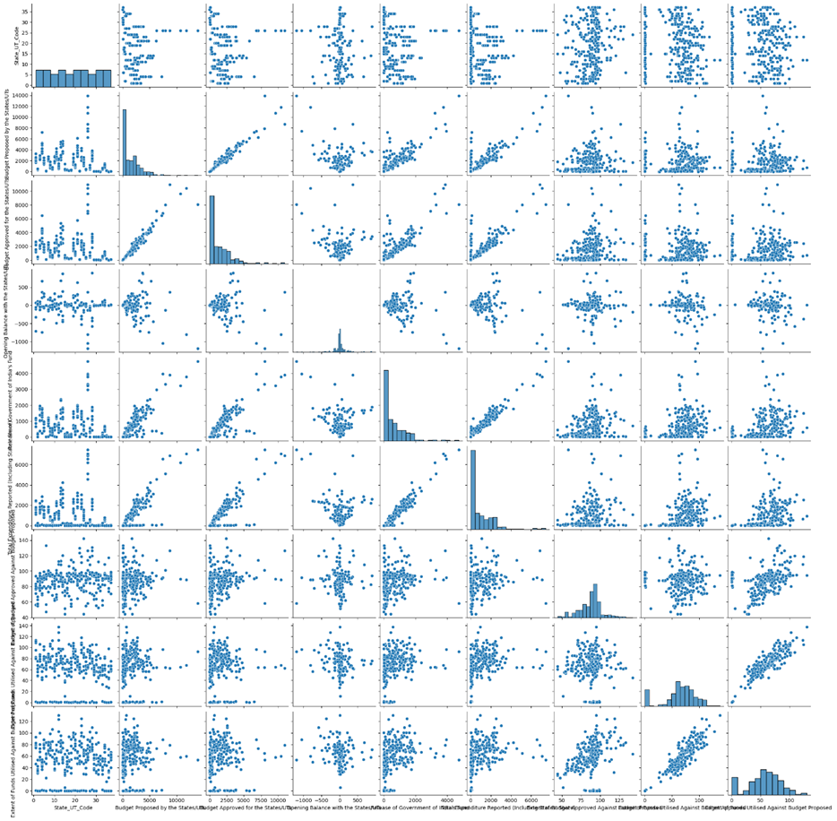
Scatter Pair plot gives an idea about each features relationship with other features.
Trend that is followed by a feature by change in value other features are captured through it.
We have made this just to find relationship between features so that we can further apply Linear Regression Model to the ones that share linear relationship.

Slide 10
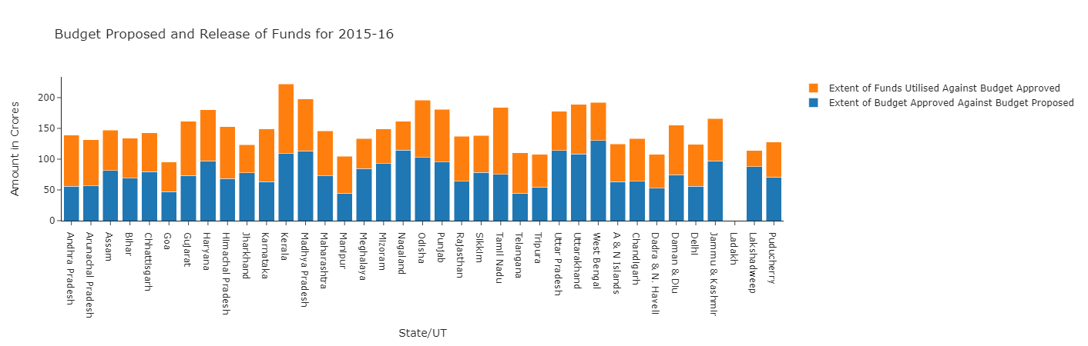
Visualization of budget utilization over the years using stacked bar charts
Funding for NRHM has generally increased over the years, with some states consistently spending more, such as Uttar Pradesh. Total budgets proposed/allocated by the government have increased annually, and some states have proposed significant budget increases for specific years, indicating a focus on improving rural health infrastructure
Notes:
Funding for NRHM has generally increased over the years, with some states consistently spending more, such as Uttar Pradesh. Total budgets proposed/allocated by the government have increased annually, and some states have proposed significant budget increases for specific years, indicating a focus on improving rural health infrastructure.

Slide 11
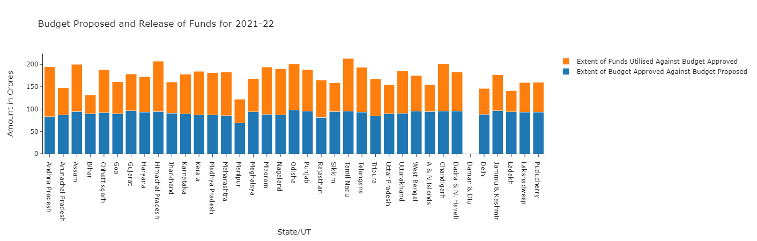
From the chart we can see that the amount of funding that states have spent on NRHM has generally increased over the years. In some years, the amount of funds used by certain states was significantly higher, while in other years the increased funds were distributed more evenly among the different states. We can also observe that some states consistently use more funds for NRHM than others, such as Uttar Pradesh, which has the highest threshold in most years. In most states, the total budget proposed/allocated by the government increases year by year. This can be seen in the upward movement of the bars.
Over the years, Uttar Pradesh, Maharashtra, Karnataka, and Gujarat have had the highest combined budgets. Sikkim, Nagaland, and Mizoram have had the lowest combined budgets for many years. Many state governments have proposed substantial increases in total budgets for 2019-20. This may be due to various factors, such as the implementation of new policies or the allocation of funds for specific projects.

Slide 12
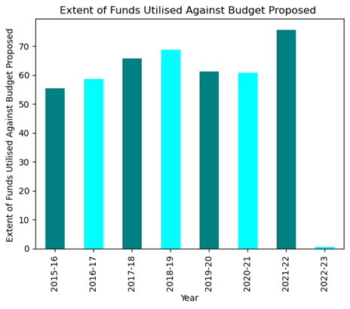
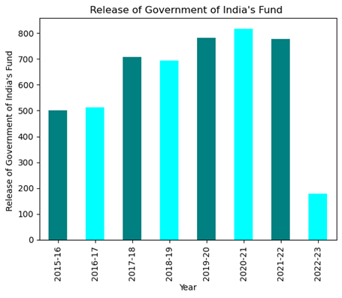
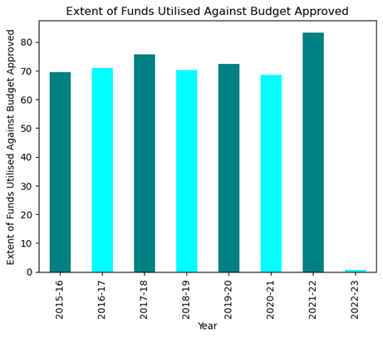
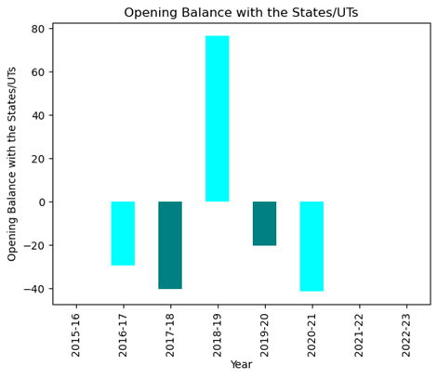
Moving average analysis to observe changes in budget stages
After the year 2016-17, there was a significant spike in funding which continued to increase in the following years as well. However, there seems to be a slight dip in funding after the year 2020-21. Overall, the trend seems to be positive and indicative of the government's increasing focus on improving rural health infrastructure.
The state government often began the year with a budget deficit, as they received less funding than what they had proposed for in most years.

Slide 13
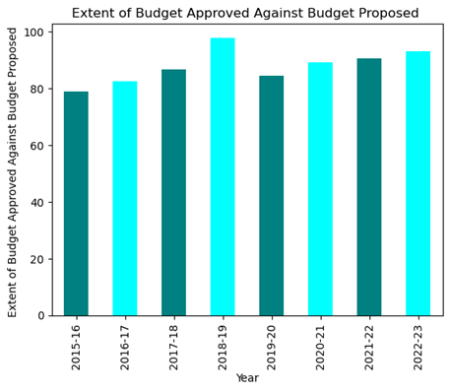
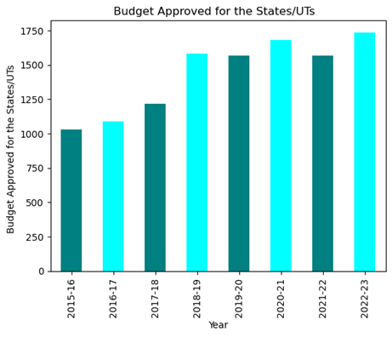
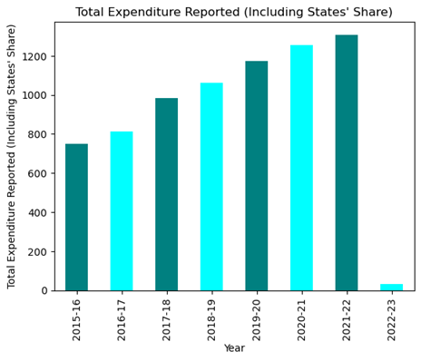
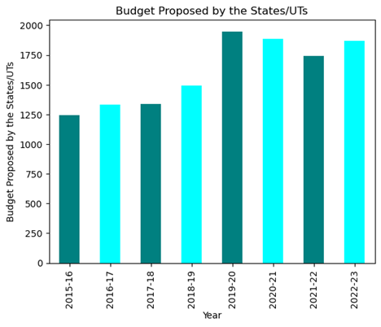
Total expenditure by the government is increasing on yearly basis as they are focusing more on health sector.

Slide 14
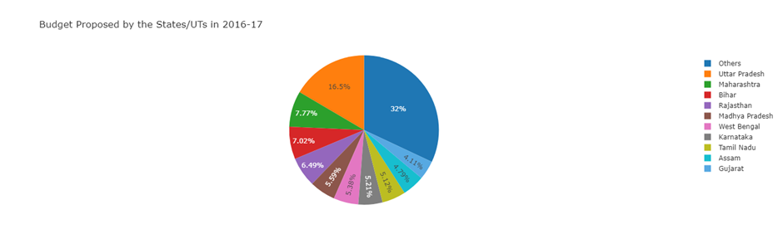
Pie chart visualization of budget share across states/UTs

Slide 15
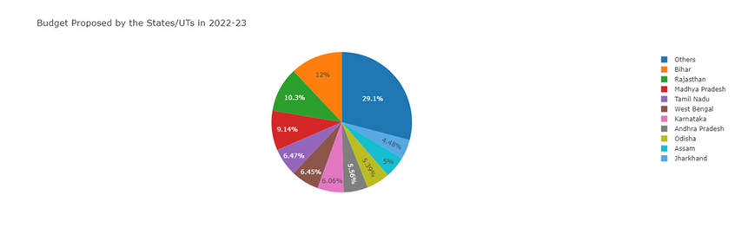
Only a few states—Uttar Pradesh, Bihar, Rajasthan, Maharashtra, Karnataka, Assam, Gujarat, Madhya Pradesh, and West Bengal—propose over 70% of the nation's total budget.
These states have more influence over how funds are distributed at the federal level.
Uttar Pradesh (UP) ranked among the top states for budget proposals across all years considered.
The remaining states account for another 30% of the total share and play a crucial role in the allocation of funds.
By analyzing trends in budget proposals, we can gain insight into which states are investing more in the health sector and which states may need more attention in this area.

Slide 16
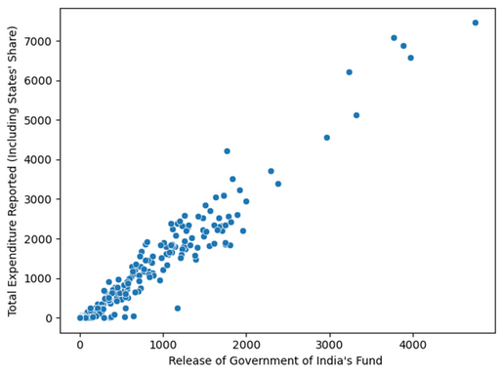
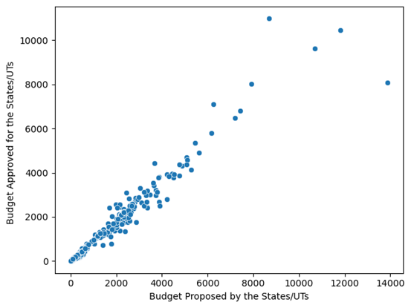
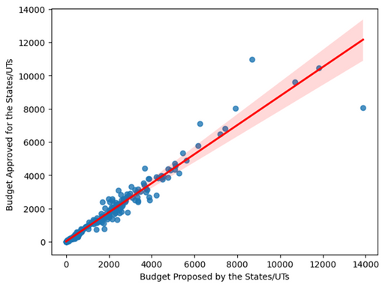
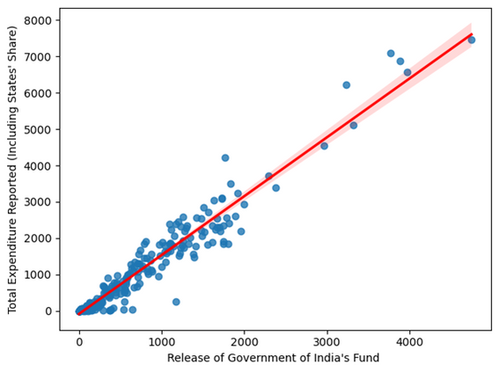
Regression model for predicting budget approval based on release of funds
Regression on Budget Proposed by the States/UTs and Budget Approved for the States/UTs
Regression on Release of Government of India's Fund and Total Expenditure Reported
Looking at the scatterplots it could be seen that Budget Proposed by the States/UTs and Budget Approved for the States/UTs has some kind of linear relationship thus we modelled it with linear regression and found that we can predict the Expenditure based on Release of funds.
Our model had R2 score of 0.98 and it did great job predicting the budget approved.
Looking at the scatterplots it could be seen that Release of Government of India's Fund and Total Expenditure Reported has some kind of linear relationship thus we modelled it with linear regression and found that we can predict the Expenditure based on Release of funds.
Our model had R2 score of 0.96 and it did great job predicting the budget approved.

Slide 17
Dataset : 2
Mobile Medical Units (MMUs) data from September 2016
This dataset tells us about the operational Mobile Medical Units (MMUs) in each state in year 2016.
Dataset overview and preprocessing
Ranking states based on operational MMUs
Bar chart visualization of the top 10 states with the most operational MMUs

Slide 18
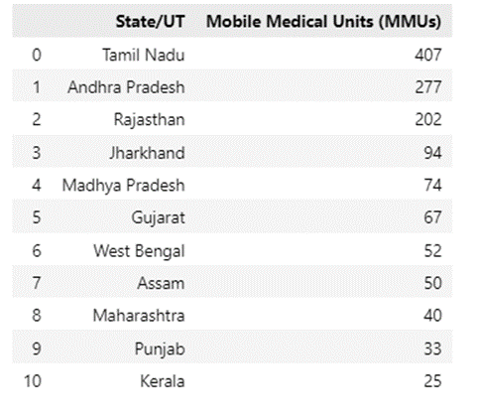
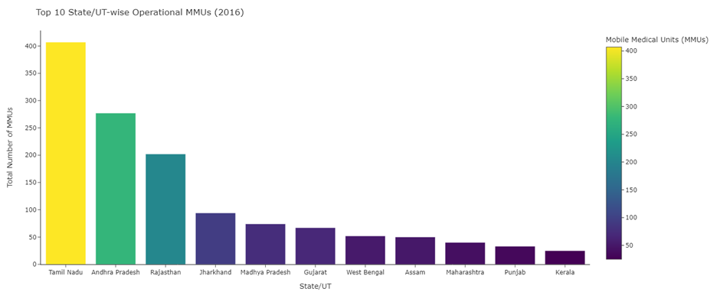
Ranking States based on operational MMUs
From the above plot, we observed that Tamil Nadu has the maximum number of operational MMUs (407) according to the data which then followed by Andhra Pradesh and Rajasthan which have 277 and 202 operational units.

Slide 19
Dataset : 3
Operational Ambulances Under NRHM (2018)
This dataset has the information about operational ambulances under NHM during 2018.
Dataset overview and preprocessing
Ranking states based on the number of operational ambulances
Stacked bar plot to represent diversity in types of ambulances across top 10 states
Info: Dataframe contains 37 rows and 6 columns, drop unnecessary rows. And rank the states based on total number of ambulances.
:

Slide 20
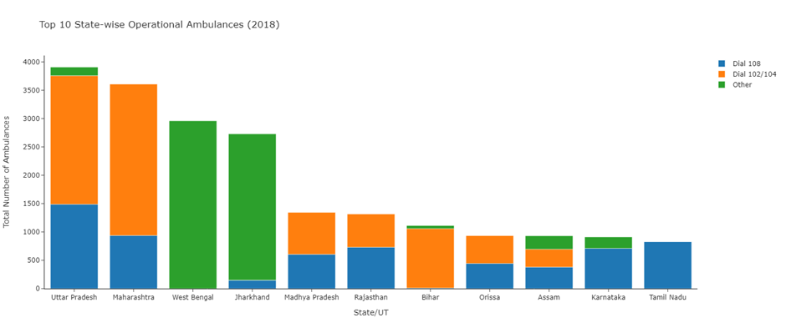
From the above plot, we can deduce that Uttar Pradesh has the greatest number of Operational Ambulances.
Also UP has the greatest number of Dial 108 ambulances whereas Maharashtra and West Bengal has the greatest number of Dial 102/104 and other ambulances respectively.

Slide 21
Dataset : 4
Established Special New-born Care Units (SNCU) under NRHM
SNCU dataset tells us about the established Special New-born Care Units in a State/UT up to January 2020.
Data visualization using Plotly library
Map of India shaded based on the number of SNCUs
GeoJSON file for state boundaries
Altered state names and added state ID column
Info: SNCU df has 38 rows and 3 columns, then we dropped unwanted columns and rows.
:

Slide 22
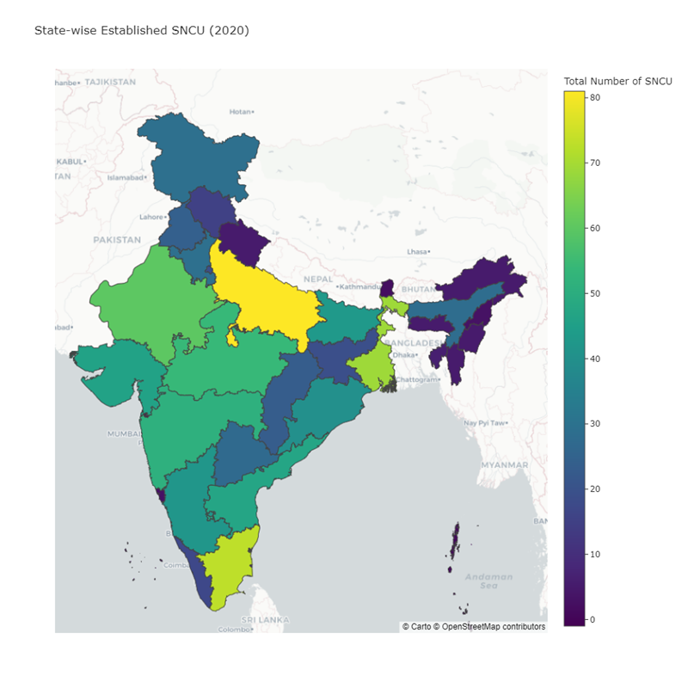
There was difference in spellings in the state name, so we altered the names for solving the problem. And added state id column in our SNCU df.
To plot the map we used choropleth_mapbox() function from Plotly express, and changed the color based on the total number of SNCU.
From the above map we can interpret that UP has the greatest number of established SNCU while north-eastern states have very a smaller number of SNCU. States like MP, Gujarat, Rajasthan, Maharashtra etc are in between.

Slide 23
Dataset : 5
Accredited Social Health Activists (ASHAs) Selected under NRHM
This dataset tells us about the number of accredited Social health activists during 2008.
ASHAs dataset overview
Removed unwanted row
Tree-map visualization for ranking of ASHAs in each state/UT
Info: Dataframe has 37 rows and 2 columns. We removed the unwanted row which contains total of all the states.

Slide 24
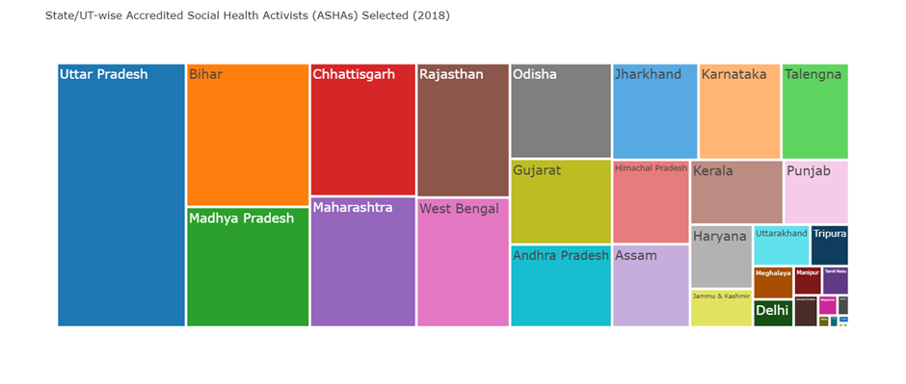
For visualization part, we used tree-map which easily shows which state/UT rank higher and which state/UT ranks lower.
From the above Tree-map, we can see that again UP has the most number of ASHAs while Bihar and MP take second and third place.

Slide 25
Dataset : 6
Health Centres Under NRHM Dataset
Health Centres dataset gives insight about several characteristics of health centres throughout the country.
Health Centres dataset overview
Heatmap to visualize null values
Dropped Facility Address column
Typecasted latitude and longitude columns
Info: Dataset has 200438 rows and 11 columns and datatype of all the columns is set to object.
:

Slide 26
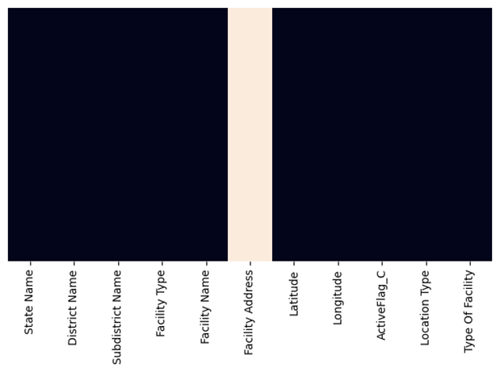
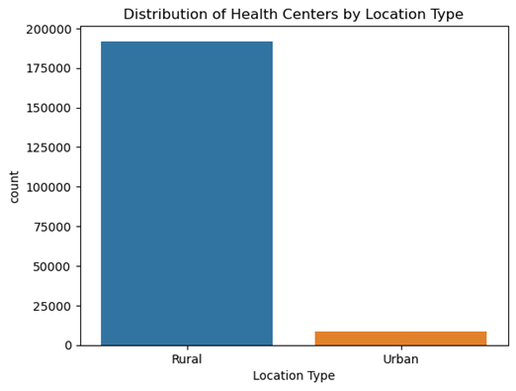
After pre-processing our data, we started plotting the graphs. The first plot tells us about the number of Rural vs Urban healthcare centres using a countplot.
From the heatmap we can saw that Facility Address column has a lot of null values, therefore we dropped that column.
We can clearly see that Rural healthcare centres are much more in numbers than Urban which tells us government focused on Rural Healthcare more.

Slide 27
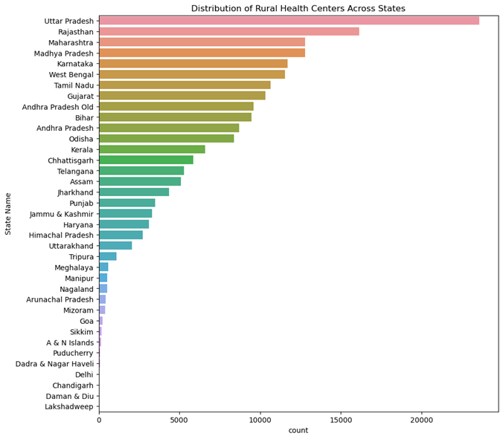
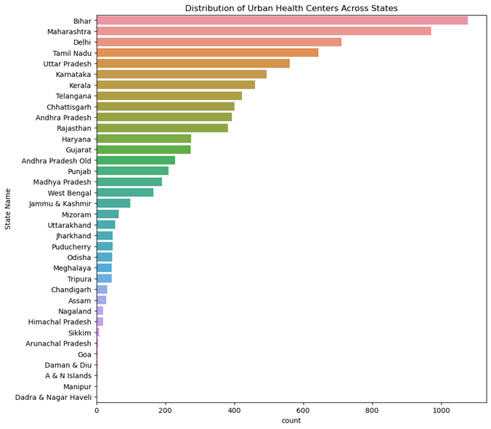
Countplot showing the number of rural and urban healthcare centres
To find out which state has most number of rural HCs we used countplot.
To find how many urban HCs are there in each State/UT we plotted countplot.
Uttar Pradesh, Bihar, Rajasthan, Maharashtra, Karnataka, Assam, Gujarat, Madhya Pradesh, and West Bengal are the leading proposers of the rural health sector budget in the country.
This suggests that these states have a significant influence on the allocation of funds at the national level.
By having a greater say in the allocation of funds, these states can prioritize their specific health needs and ensure necessary resources for their rural populations.
This can lead to better health outcomes, improved access to healthcare and ultimately a healthier population.
An increased focus on rural health management could significantly improve health outcomes in these states.
A few states, namely Bihar, Maharashtra, Tamil Nadu, Delhi, Uttar Pradesh, and Karnataka, seem to care more about urban health than rural health.
This could be due to the greater concentration of infrastructure and resources in urban areas, as well as the higher population densities there.
Neglecting rural health can have major repercussions, as rural inhabitants frequently have poor access to healthcare and are more susceptible to a range of health issues.
States and governments must give rural and urban health care systems top priority and funding to guarantee that everyone has access to high-quality healthcare, regardless of where they live or their socioeconomic status. This can be accomplished in several ways, including by boosting funding for rural health programmes, enhancing the facilities and resources available there, and encouraging medical personnel to practise in rural regions.

Slide 28
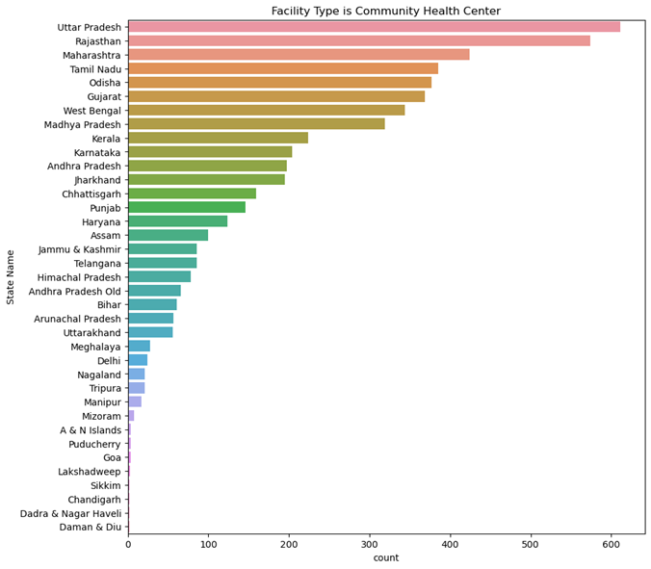
Plotted multiple count-plot to get State/UT-wise count of different type of facilities.
UP and Rajasthan has a greater number of Community Health Centres. Maybe their geographical size is the reason for this.

Slide 29
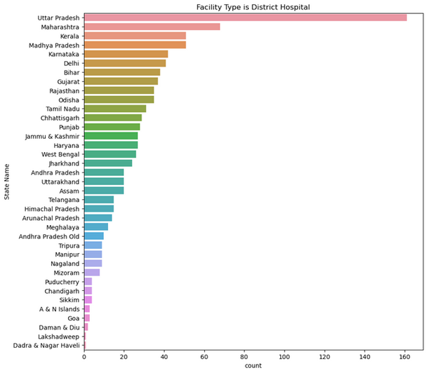
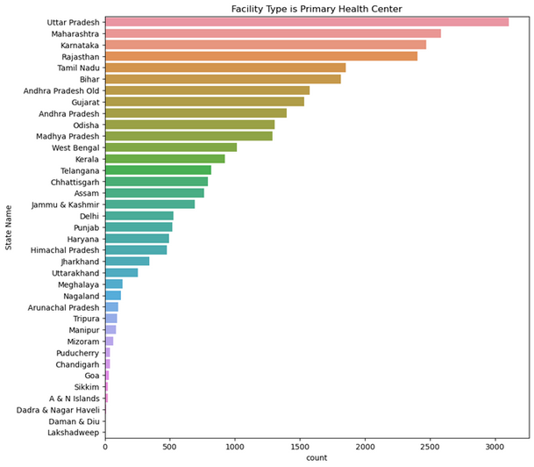
Most number of district hospitals are in UP, since UP has highest number of districts, but other states like MP, which has more districts than Maharashtra, has lower number of District hospitals.
UP once again has highest number of primary health centres as well.

Slide 30

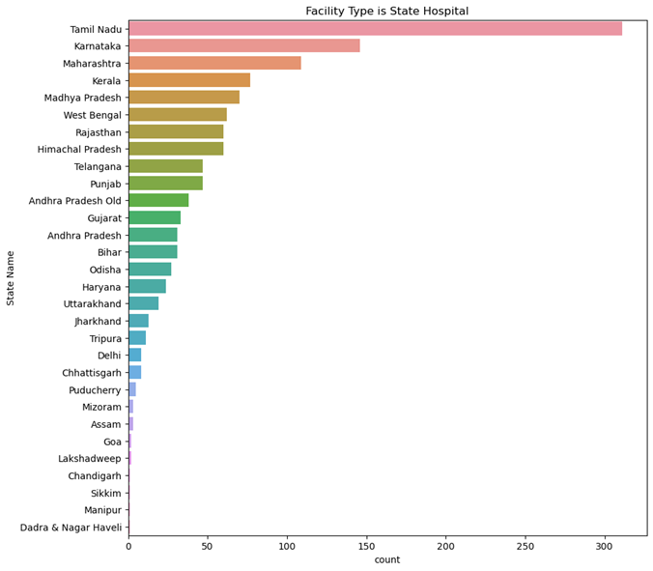
From the above plots we can conclude that State of UP has highest number of Health Centres in each category. While North-Eastern States have lower number.

Slide 31
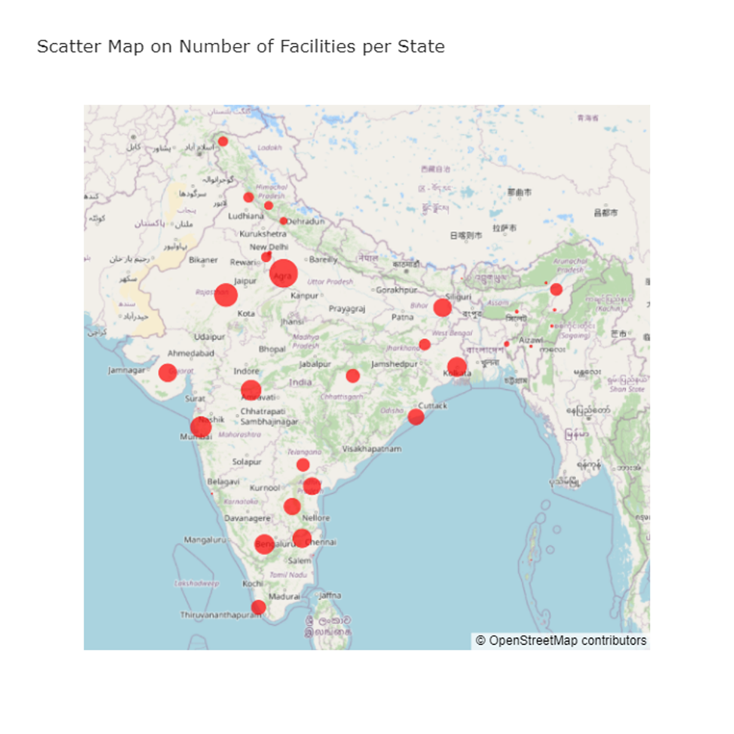
Map showing the total number of healthcare centres in each state/UT
Grouping rows and creating a new dataframe with latitude and longitude
Scatter plot on the map with bubble size representing the number of facilities

Slide 32

CONCLUSION
The National Rural Health Mission (NRHM) and National Health Mission (NHM) are government programs that aim to improve healthcare facilities in rural and urban areas.
These programs have been successful in allocating significant funds for improving healthcare facilities.
They have also been successful in increasing the number of ambulances, MMUs, SNCUs, and ASHAs.
However, there are still some disparities in the distribution of healthcare facilities, with UP consistently on the top of the list while north-eastern states are at the bottom.
Overall, the NRHM and NHM have been successful in improving healthcare facilities in India, but there is still room for improvement.

Slide 33

References
DA-IICT
For definitions:
https://nhm.gov.in/index1.php?lang=1&level=1&lid=49&sublinkid=969
For data collection:
https://data.gov.in/
https://openbudgetsindia.org/dataset/national-health-mission
For plots:
https://plotly.com/python/
https://seaborn.pydata.org/examples/index.html
https://matplotlib.org/stable/gallery/color/named_colors.html

Slide 34
THANK YOU
DA-IICT

